Slide 1

Code Refactoring and Bug Fixing

Slide 2
About me
I’m Dasari sai srujan goud, a passionate data scientist with a keen interest in leveraging data-driven insights to solve complex problems and drive strategic decision-making. With a strong foundation in statistics, machine learning, and data analysis, I thrive in transforming raw data into actionable insights that empower organizations to make informed choices.
Connect with me on LinkedIn: https://www.linkedin.com/in/dasari-sai-srujan-goud-450798273/ and explore my projects on GitHub: https://github.com/Dasarisaisrujangoud .

Slide 3
Objective of the Project
The objective of the project is to resolve the existing codebase to ensure the proper functionality.
Identifying the bugs and fixing the bugs in the existing system within the codebase to restore the applications intended functionality.
The main goal of the refactoring the code is to meets the user expections efficiently.

Slide 4
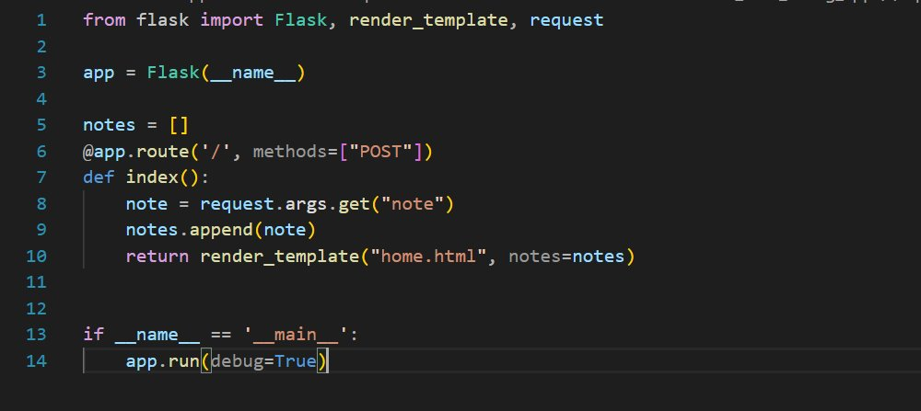
BUGS AND FIXING THE CODE code:

Slide 5
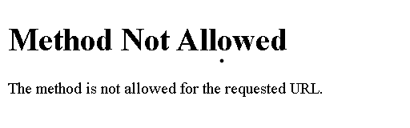
Error In Application
The Missing route for rendering the homepage leads to unexpected functionality .

Slide 6
Identifying the error
This code is a simple flask application, which creates a web server to handle requests. It has defined a single route(“/”) that responds to either ‘GET’ and ‘POST’ requests.​
Inside ‘index’ function , this code is checking the type of request method.

Slide 7
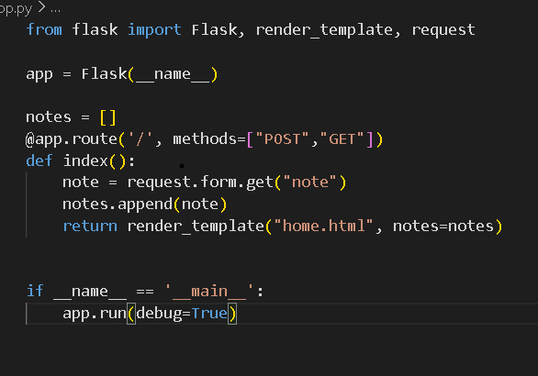
Fixing the bugs
request.args.get("note") is used to get query parameters from the URL. But we need retrieve the content which is entered by the user in the input field to be able to render on home page.​
So, by using POST request, we should use request.form.get("note") instead.​
Also, we should include both ‘GET’ and ‘POST’ methods because when we load a page , we need GET request and when we submit the form it is a POST request​

Slide 8
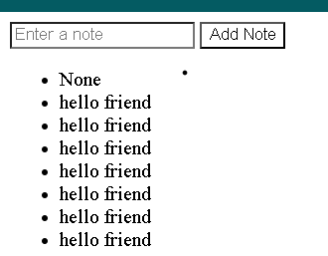
Bugs Verification
Run and verify the application.

Slide 9
Conclusion
I had concluded that I’m successfully debug and fix the error in the application . Debugging takes the crucial plays in application building to meet the efficient and user exceptions.
Through Debugging solve the errors and make the proper functionality in the application.
Using the “GET” method and “Form” method resolve the error In the application.

Slide 10

THANK YOU

